Slide 1
GitHub MCP Server
Name: MAHENDRA KUMAR REDDY KAKARLA
e-mail: mahendrakumarreddykakarla@gmail.com
Phone no: +91 8074394602
Repo_link: https://github.com/BBB2912/GithubMCP/tree/master
Server results: claude Chat links
https://claude.ai/share/12af514c-23f3-42cb-b921-825ff509866f
https://claude.ai/share/db927b52-ecc7-4e4f-b264-805ad70a8104

Slide 2
Introduction
Project Name: GitHub MCP Server
Purpose: Automate GitHub interactions using MCP (Model Context Protocol)
Developed for: Integration with LLMs like Claude, CLI, and API requests

Slide 3
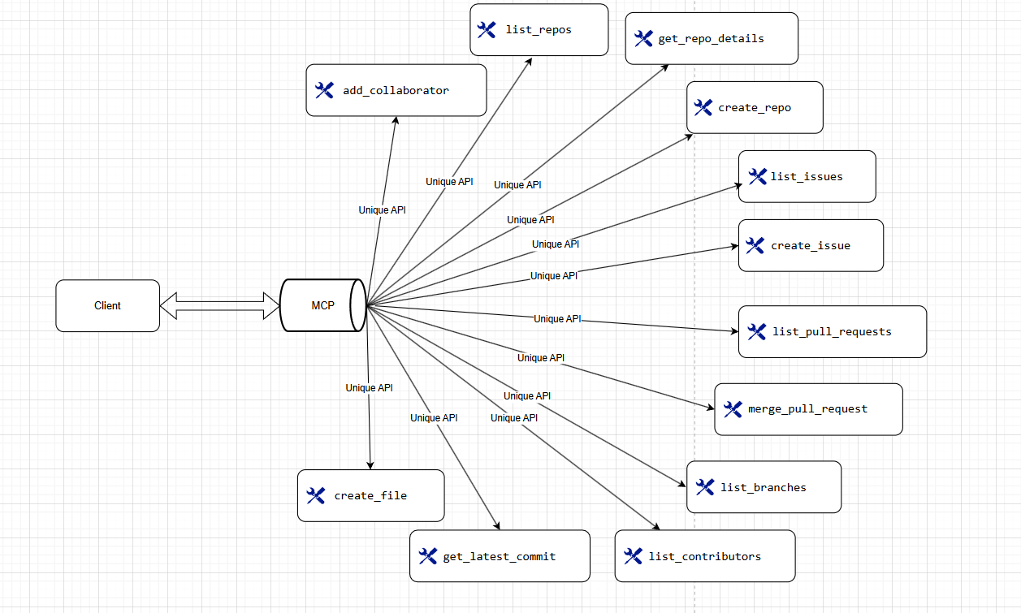
Server Architecture

Slide 4
Features of GitHub MCP Server
Automates GitHub operations
Uses MCP for tool execution
Supports both public & private repositories
Secure authentication with GitHub API
Tools available:
Repository Management: List, Get details, Create repositories
Issues & PRs: List & Create issues, Merge pull requests
Commits & Branches: Fetch latest commit, List branches
Collaborators: List contributors, Add collaborators
File Management: Create a new file in a repository

Slide 5
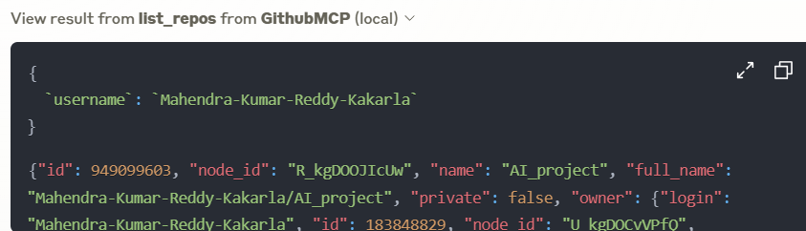
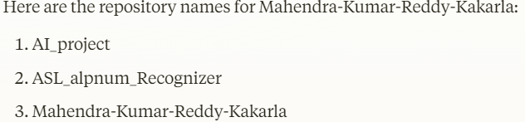

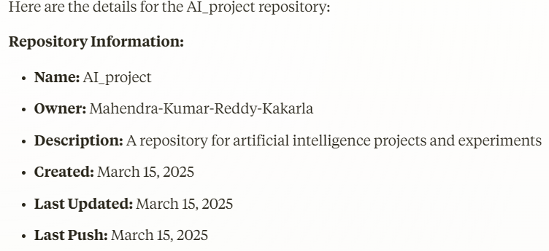
GitHub MCP server results
list_repos
get_repo_details
create_repo

Slide 6
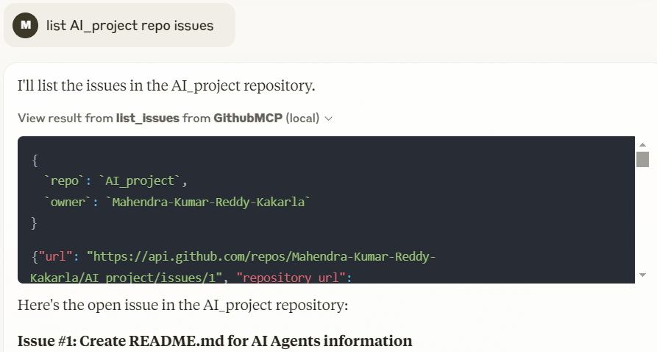
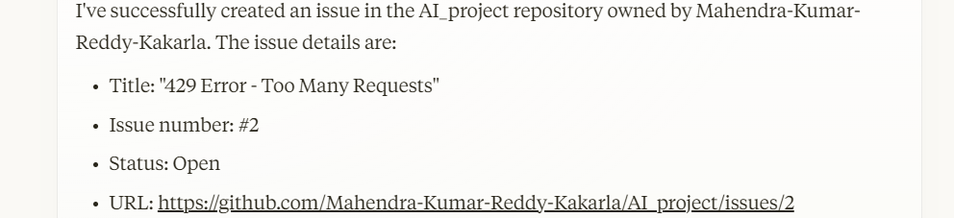
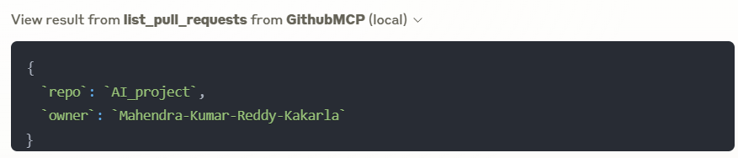
GitHub MCP server results
list_issues
create_issue
list_pull_requests

Slide 7
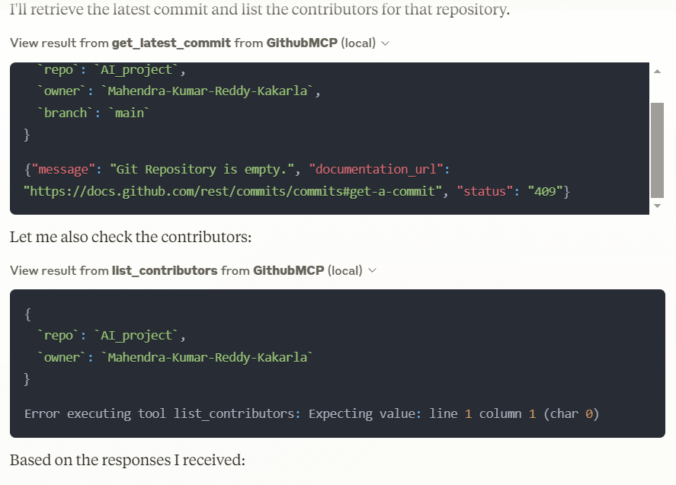
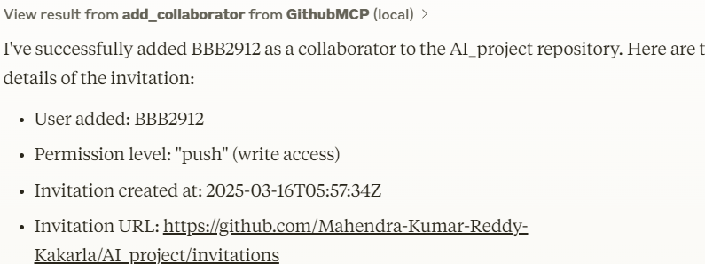
GitHub MCP server results
get_latest_commit, list_contributors
add_collaborator

Slide 8
Github MCP server results
Due to ppt length issues I mensioned the chat linkes go and checkit out
https://claude.ai/share/db927b52-ecc7-4e4f-b264-805ad70a8104
https://claude.ai/share/12af514c-23f3-42cb-b921-825ff509866f

Slide 9
Tech Stack Used
Backend: Python, requests, MCP SDK
API Integration: GitHub REST API
Server Execution: UV, FastMCP
Client: Claude, CLI, Custom API requests
Server setup:
https://github.com/BBB2912/GithubMCP/blob/master/README.md
Follw the instructions from above readme file

Slide 10
Conclusion & Next Steps
Expand tools: Add GitHub Actions support
Enhance client integration
Deploy the server for real-world use
Contribute to open source!

Slide 11
Thank You

